Slide 1
UNIT 3

Slide 2
Data mart
Data mart is such a storage component which is concerned on a specific department of an organization.
It is a subset of the data stored in the data warehouse.
Data mart is focused only on particular function of an organization and it is maintained by single authority only, e.g.m finance, Marketing.
Data Marts are small in size and are flexible.

Slide 3
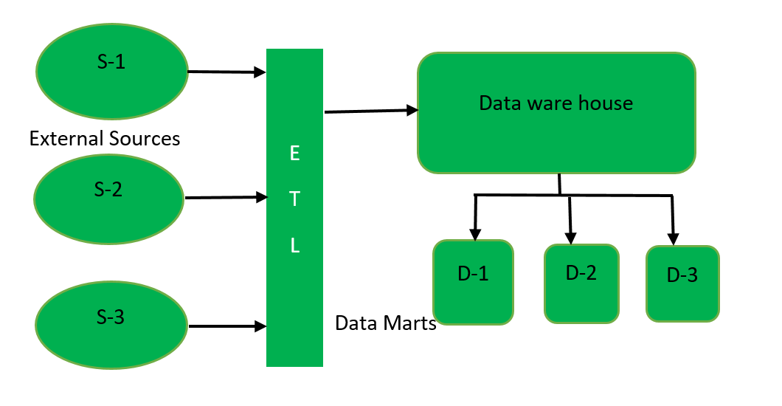
Types of Data Mart: There are three types of data marts:
Dependent Data Mart is created by extracting the data from central repository, Datawarehouse.
First data warehouse is created by extracting data (through ETL tool) from external sources and then data mart is created from data warehouse.
Dependent data mart is created in top-down approach of data warehouse architecture.
This model of data mart is used by big organizations.
1. Dependent Data Mart –

Slide 4
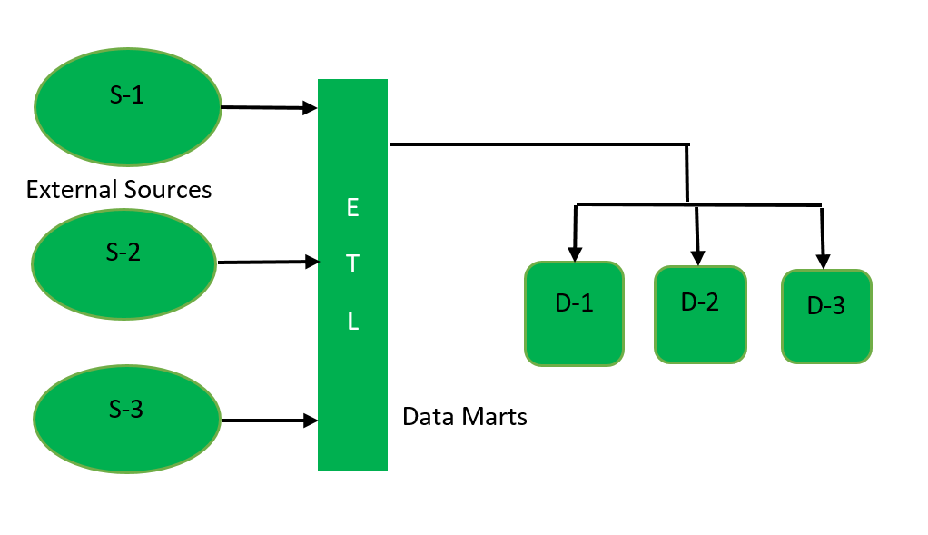
2. Independent Data Mart –
Independent Data Mart is created directly from external sources instead of data warehouse.
First data mart is created by extracting data from external sources and then data warehouse is created from the data present in data mart.
Independent data mart is designed in bottom-up approach of data warehouse architecture.
This model of data mart is used by small organizations and is cost effective comparatively.

Slide 5
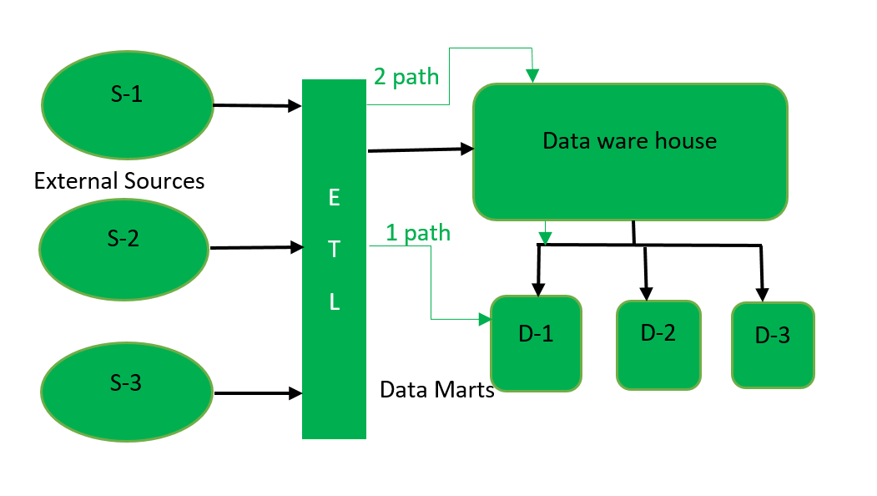
3. Hybrid Data Mart –
This type of Data Mart is created by extracting data from operational source or from data warehouse.
1Path reflects accessing data directly from external sources and 2Path reflects dependent data model of data mart.

Slide 6
Need Of Data Mart:
Data Mart focuses only on functioning of particular department of an organization.
It is maintained by single authority of an organization.
Since, it stores the data related to specific part of an organization, data retrieval from it is very quick.

Slide 7
Advantages of Data Mart:
Implementation of data mart needs less time as compared to implementation of data ware house as data mart is designed for a particular department of an organization.
Data can be easily accessed from data mart.
It contains frequently accessed queries, so enable to analyze business trend.
Disadvantages of Data Mart:
Since it stores the data related only to specific function, so does not store huge volume of data related to each and every department of an organization like dataware house.
Creating too many data marts becomes cumbersome sometimes.

Slide 8
Metadata
Often referred to as data that describes other data, metadata is structured reference data that helps to sort and identify attributes of the information it describes.
Meta is a prefix that -- in most information technology usages -- means "an underlying definition or description.
" Metadata summarizes basic information about data, which can make it easier to find, use and reuse particular instances of data.
For example, author, date created, date modified and file size are examples of very basic document file metadata.
Having the ability to search for a particular element (or elements) of that metadata makes it much easier for someone to locate a specific document.

Slide 9
In addition to document files, metadata is used for:
computer files
images
relational databases
spreadsheets
videos
audio files
web pages

Slide 10
What is Multi-Dimensional Data Model?
A multidimensional model views data in the form of a data-cube.
A data cube enables data to be modeled and viewed in multiple dimensions.
It is defined by dimensions and facts.
The dimensions are the perspectives or entities concerning which an organization keeps records.
For example, a shop may create a sales data warehouse to keep records of the store's sales for
the dimension time,
item, and
location.

Slide 11
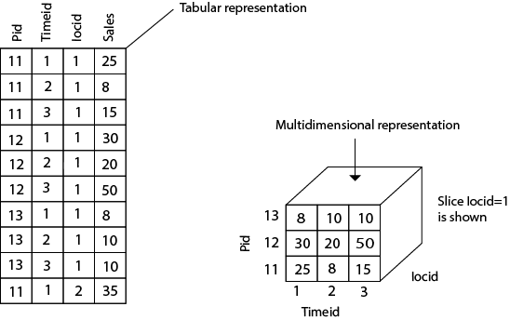
These dimensions allow the save to keep track of things, for example, monthly sales of items and the locations at which the items were sold.
Each dimension has a table related to it, called a dimensional table, which describes the dimension further.
For example, a dimensional table for an item may contain the attributes item_name, brand, and type.
A multidimensional data model is organized around a central theme, for example, sales. This theme is represented by a fact table.
Facts are numerical measures. The fact table contains the names of the facts or measures of the related dimensional tables.

Slide 12
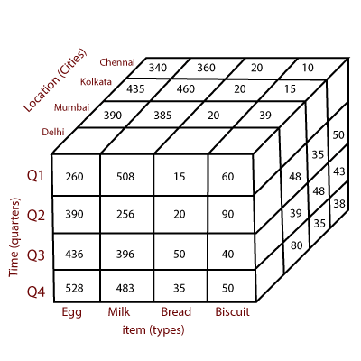
Consider the data of a shop for items sold per quarter in the city of Delhi.
The data is shown in the table.
In this 2D representation, the sales for Delhi are shown for the time dimension (organized in quarters) and the item dimension (classified according to the types of an item sold).
The fact or measure displayed in rupee_sold (in thousands).

Slide 13
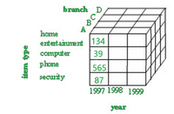
What is OLAP?
OLAP stands for Online Analytical Processing, which is a technology that enables multi-dimensional analysis of business data.
It provides interactive access to large amounts of data and supports complex calculations and data aggregation.
OLAP is used to support business intelligence and decision-making processes.
Grouping of data in a multidimensional matrix is called data cubes.
In Data warehousing, we generally deal with various multidimensional data models as the data will be represented by multiple dimensions and multiple attributes.
This multidimensional data is represented in the data cube as the cube represents a high-dimensional space.
The Data cube pictorially shows how different attributes of data are arranged in the data model. Below is the diagram of a general data cube.
The example above is a 3D cube having attributes like branch(A,B,C,D),item type(home,entertainment,computer,phone,security), year(1997,1998,1999) .

Slide 14
Data cube classification:
The data cube can be classified into two categories:
Multidimensional data cube: It basically helps in storing large amounts of data by making use of a multi-dimensional array.
It increases its efficiency by keeping an index of each dimension. Thus, dimensional is able to retrieve data fast.
Relational data cube: It basically helps in storing large amounts of data by making use of relational tables.
Each relational table displays the dimensions of the data cube.
It is slower compared to a Multidimensional Data Cube.

Slide 15
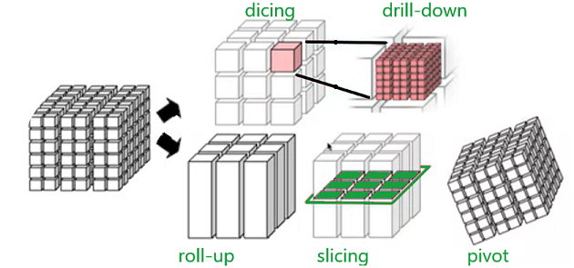
Data cube operations/ OLAP Operation

Slide 16
Data cube operations are used to manipulate data to meet the needs of users. These operations help to select particular data for the analysis purpose.
There are mainly 5 operations listed below-
Roll-up:
operation and aggregate certain similar data attributes having the same dimension together.
For example, if the data cube displays the daily income of a customer, we can use a roll-up operation to find the monthly income of his salary.

Slide 17
Drill-down:
this operation is the reverse of the roll-up operation.
It allows us to take particular information and then subdivide it further for coarser granularity analysis.
It zooms into more detail.
For example- if Nepal is an attribute of a country column and we wish to see villages in Nepal , then the drill-down operation splits Nepal into states, districts, towns, cities, villages and then displays the required information.

Slide 18
Slicing:
this operation filters the unnecessary portions.
Suppose in a particular dimension, the user doesn’t need everything for analysis, rather a particular attribute.
For example, country=”jamaica”, this will display only about jamaica and only display other countries present on the country list.

Slide 19
Dicing:
This operation does a multidimensional cutting, that not only cuts only one dimension but also can go to another dimension and cut a certain range of it.
As a result, it looks more like a sub cube out of the whole cube(as depicted in the figure).
For example- the user wants to see the annual salary of Bagmati state employees.

Slide 20
Pivot:
This operation is very important from a viewing point of view.
It basically transforms the data cube in terms of view.
It doesn’t change the data present in the data cube.
For example, if the user is comparing year versus branch, using the pivot operation, the user can change the viewpoint and now compare branch versus item type.

Slide 21
Advantages of data cubes:
Multi-dimensional analysis: Data cubes enable multi-dimensional analysis of business data, allowing users to view data from different perspectives and levels of detail.
Interactivity: Data cubes provide interactive access to large amounts of data, allowing users to easily navigate and manipulate the data to support their analysis.
Speed and efficiency: Data cubes are optimized for OLAP analysis, enabling fast and efficient querying and aggregation of data.

Slide 22
Disadvantages of data cube:
Complexity: OLAP systems can be complex to set up and maintain, requiring specialized technical expertise.
Data size limitations: OLAP systems can struggle with very large data sets and may require extensive data aggregation or summarization.
Performance issues: OLAP systems can be slow when dealing with large amounts of data, especially when running complex queries or calculations.

Slide 23
What is OLTP?
OLTP (Online Transaction Processing) is an approach to database management that focuses on the management and processing of real-time transactions.
Unlike OLAP (Online Analytical Processing), which focuses on the analysis and exploration of large data sets, OLTP is used to manage and control day-to-day business operations involving individual transactions.
OLTP main features:
Real-time transactions:
OLTP is designed to handle individual transactions in real time, which means that data is updated and processed immediately as transactions occur.
Frequent queries and updates: OLTP systems are optimized to perform read and write operations with high frequency and efficiency.
They are designed to allow multiple users to simultaneously access and make c Changes to data concurrently.

Slide 24
3.Database structure: OLTP databases generally have a highly normalized design to minimize redundancy and ensure data integrity.
This helps to maintain consistency of information in environments where there are many transactions affecting the same data.
4.Size of the database: Although OLTP databases can contain large amounts of data, their size is generally smaller compared to Data Warehouses used in OLAP.
5.Focus on availability and integrity: OLTP systems place significant emphasis on ensuring the availability and integrity of data at all times.
This involves maintaining high system availability and ensuring that transactions are error-free and maintain data consistency.
Examples of OLTP applications include online database management systems for financial transactions, online reservation and sales systems, inventory control systems, patient registration systems in hospitals and any other application requiring immediate and efficient processing of individual transactions.

Slide 25
What is OLAP?
OLAP (Online Analytical Processing) is a technology and approach to advanced data analysis that allows users to explore and derive meaningful information from large data sets from multiple perspectives.
Unlike OLTP (Online Transaction Processing), which focuses on real-time transaction management, OLAP focuses on the analysis and discovery of patterns, trends and relationships in data stored in a data warehouse or other multidimensional databases.

Slide 26
OLAP main features:
Multidimensional data: OLAP organizes data into multidimensional structures known as 'OLAP cubes’.
These cubes contain data in different dimensions, such as time, product, location and category, allowing users to analyze data from different perspectives.
2 Complex analytical operations: OLAP systems support complex analytical operations such as drill-down/drill-up, filtering, rotation, segmentation and roll-up.
These operations allow users to explore data at different levels of detail and gain deeper insights.

Slide 27
Data aggregation: OLAP allows summarizing and aggregating data to obtain a more general and comprehensive view of the data.
This is useful for aggregate analysis such as totals, averages, peaks and throughs.
Fast response: OLAP systems are optimized to provide fast responses to complex queries.
They use efficient processing and pre-calculation techniques to speed up data analysis and retrieval.
Decision support: OLAP is used to analyze large volumes of business data and provide valuable information for informed decision-making.
Users can gain a deeper understanding of trends and patterns, enabling them to make better strategic and tactical decisions.

Slide 28
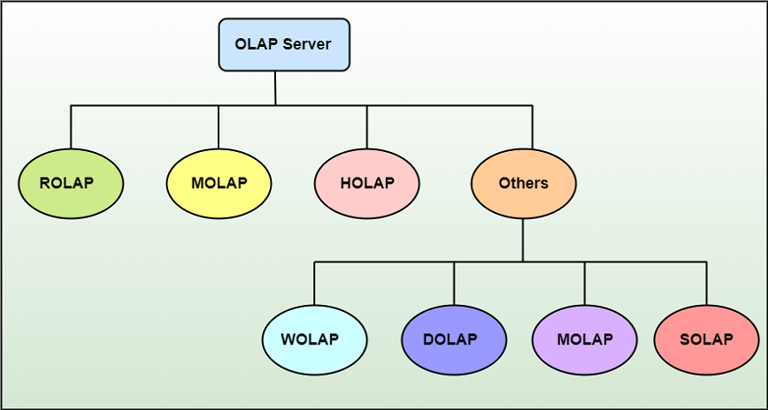
Types of OLAP
There are three main types of OLAP servers are as following:
ROLAP stands for Relational OLAP, an application based on relational DBMSs.
MOLAP stands for Multidimensional OLAP, an application based on multidimensional DBMSs.
HOLAP stands for Hybrid OLAP, an application using both relational and multidimensional techniques.

Slide 29
Relational OLAP (ROLAP) Server
These are intermediate servers which stand in between a relational back-end server and user frontend tools.
They use a relational or extended-relational DBMS to save and handle warehouse data, and OLAP middleware to provide missing pieces.
ROLAP servers contain optimization for each DBMS back end, implementation of aggregation navigation logic, and additional tools and services.
ROLAP technology tends to have higher scalability than MOLAP technology.
ROLAP systems work primarily from the data that resides in a relational database, where the base data and dimension tables are stored as relational tables. This model permits the multidimensional analysis of data.
This technique relies on manipulating the data stored in the relational database to give the presence of traditional OLAP's slicing and dicing functionality. In essence, each method of slicing and dicing is equivalent to adding a "WHERE" clause in the SQL statement.

Slide 30
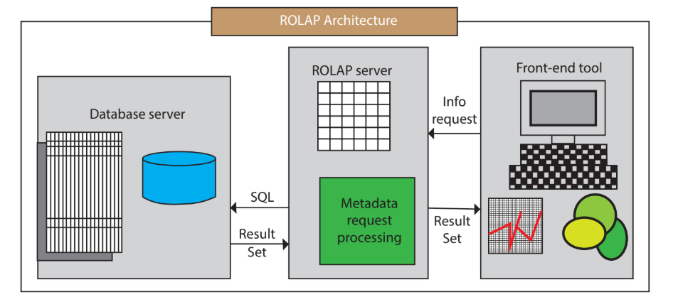
Relational OLAP Architecture
ROLAP Architecture includes the following components
Database server.
ROLAP server.
Front-end tool.

Slide 31
Relational OLAP (ROLAP) is the latest and fastest-growing OLAP technology segment in the market.
This method allows multiple multidimensional views of two-dimensional relational tables to be created, avoiding structuring record around the desired view.
Some products in this segment have supported reliable SQL engines to help the complexity of multidimensional analysis.
This includes creating multiple SQL statements to handle user requests, being 'RDBMS' aware and also being capable of generating the SQL statements based on the optimizer of the DBMS engine.

Slide 32
MOLAP
Multidimensional OLAP (MOLAP) Server
A MOLAP system is based on a native logical model that directly supports multidimensional data and operations.
Data are stored physically into multidimensional arrays, and positional techniques are used to access them.
One of the significant distinctions of MOLAP against a ROLAP is that data are summarized and are stored in an optimized format in a multidimensional cube, instead of in a relational database.
In MOLAP model, data are structured into proprietary formats by client's reporting requirements with the calculations pre-generated on the cubes.

Slide 33
Key Takeaways
MOLAP promotes better-informed business decisions through analysis of data an organization already has generated.
MOLAP has applications throughout the organization — in sales, marketing, finance, merchandising, manufacturing.
In MOLAP systems, data stored in data warehouses is copied into multidimensional data cubes optimized for fast querying based on the types of questions an organization's analysts ask most often.

Slide 34
All this is accomplished through four primary MOLAP data analysis functions:
Drilling down into more detailed data. For example, seeing which SKU delivered the highest growth in a product family, or going even more deeply to see how that growth differed by region or even individual stores within a region.
Rolling up into higher-level summary data — the opposite of the drill-down example, e.g., understanding performance by region instead of by state or county.
Slice-and-dice to segment data. For example, exploring sales by product, month and store at the same time.
Pivot to rotate the view of a selected data set so a business leader can view it from a different perspective. An example: viewing a product's sales during a given year by location, and then pivoting to view its overall sales over several years.

Slide 35
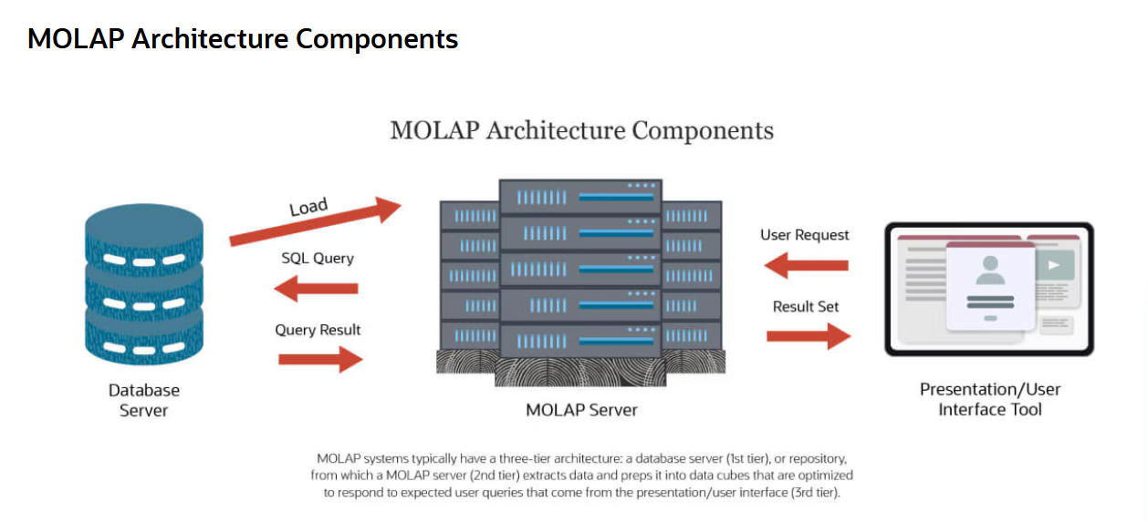

Slide 36
MOLAP Architecture
A typical MOLAP system contains three conceptual components:
Database server,
MOLAP server
Presentation tool
That accepts analysts' queries and delivers the results.
These work together in the following way:
Database server.
In a traditional three-tier MOLAP architecture, the database server is the first tier.
It serves as the repository for data that is extracted from multiple sources and then cleaned and integrated.

Slide 37
MOLAP server.
The middle tier of a MOLAP system is the MOLAP server, which retrieves data from the data warehouse (typically via SQL) and loads it into multidimensional data cubes optimized for the data requests business managers and analysts are expected to make.
The MOLAP server also responds to those user queries, sending results to the presentation layer/user interface.
Presentation, or front-end, tool.
Working through this tool, managers, analysts and other business professionals explore the information stored in data cubes in the MOLAP server.
They create requests, typically by using point-and-click tools.
Their requests are sent to the MOLAP server for processing, often using a data manipulation language created specifically to work with multidimensional data cubes and servers, such as MDX.

Slide 38
Hybrid OLAP (HOLAP) Server
HOLAP incorporates the best features of MOLAP and ROLAP into a single architecture.
HOLAP systems save more substantial quantities of detailed data in the relational tables while the aggregations are stored in the pre-calculated cubes.
HOLAP also can drill through from the cube down to the relational tables for delineated data.
The Microsoft SQL Server 2000 provides a hybrid OLAP server.

Slide 39
